Slide 1
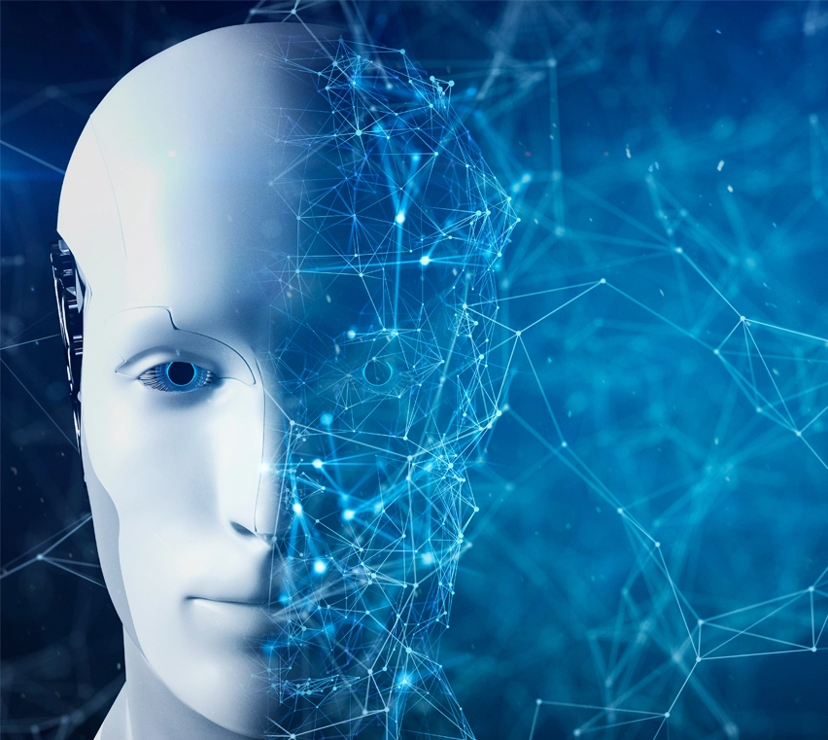
Artificial Intelligence
If we can make machine do human task it is AI.
Manmade effort to copy natural intelligence

Slide 2
Examples
DAILY HUMAN TASKS
Driving a cars
playing videogames
face and object recognization
translating languages
ARTIFICIAL INTELLIGENCE TASKS
Tesla (automatic cars)
Bots in videogames(BGMI or PUBG)
Smart locks in mobile , google lens
google translator

Slide 3
Now we know what is AI but how do we actually make Artificial Intelligence?
Machine learning and deep learning

Slide 4

Machine Learning
Making machine learn from data using some algorithms and then using what it has learned from data to make predictions on new similar data.

Slide 5
Deep Learning
Set of machine learning algorithms based on functioning of human brain.
ANN (artificial neural network), generally used with tabular data containing the features
CNN(convolution neural network), used with image data
RNN(recurrent neural network), used with audio or speech as data

Slide 6
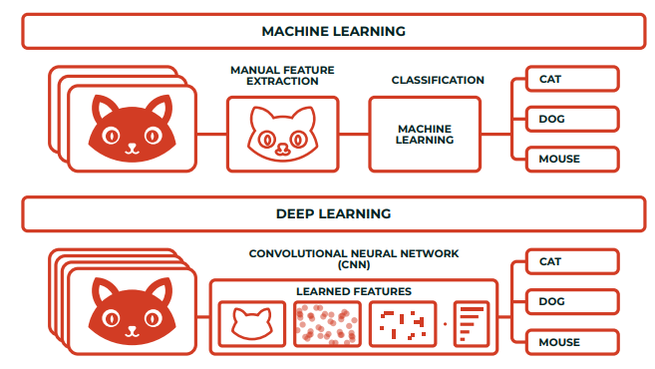
In ML we have to give features to the model.
In DL we only have to give input and neural network will itself take out features

Slide 7
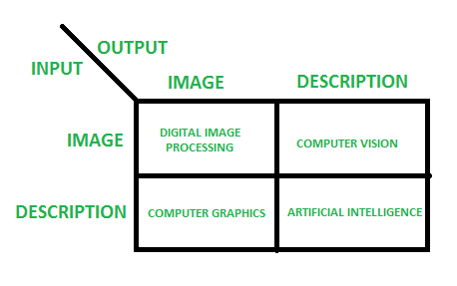
Computer vision vs Image processing
Computer vision is the construction of explicit, meaningful descriptions of physical objects from their image. The output of computer vision is a description or an interpretation of structures in 3D scene
Image processing studies image to image transformation. The input and output of image processing are both images.

Slide 8
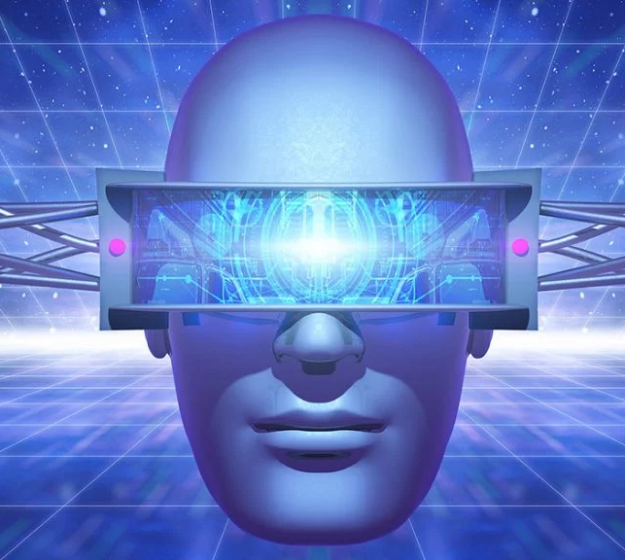
Our focus is mainly on-
Computer vision applications like--
Image classification
Object detection
Image segmentation

Slide 9
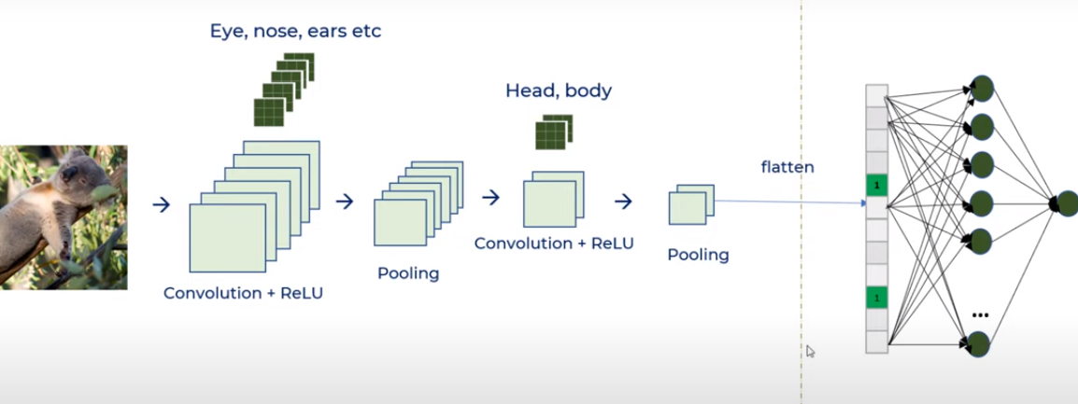
Convolution Neural Network
In deep learning, a
CNN or ConvNet is a class of deep neural networks, generally applied to analyzing visual imagery

Slide 10
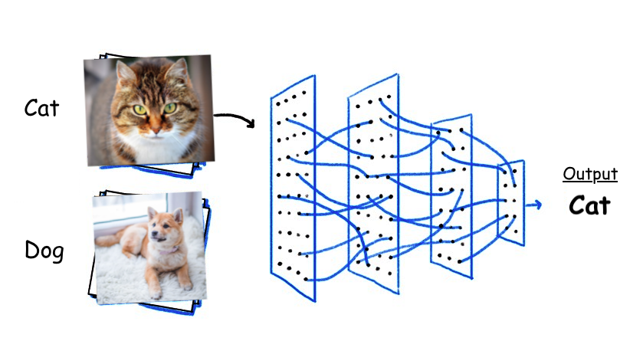
Image Classification
2 approaches-
Making neural network ourself by specifying convolution layer, pooling and fully connected layer and training it on dataset(CNN)
Transfer learning – already developed models that were trained on million of images and have their weights adjusted thus saving time and computational power. (mobilenetV2)

Slide 11
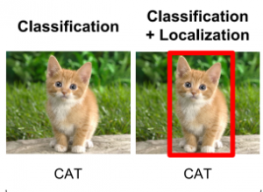
Object Localization
Classifying a single object in an image along with Bounding boxes.

Slide 12

Object Detection
Classifying multiple objects in an image with bounding boxes .
Algorithms-
Faster R CNN(region based CNN)
SSD (single shot detector)
Yolo (you only look once)

Slide 13
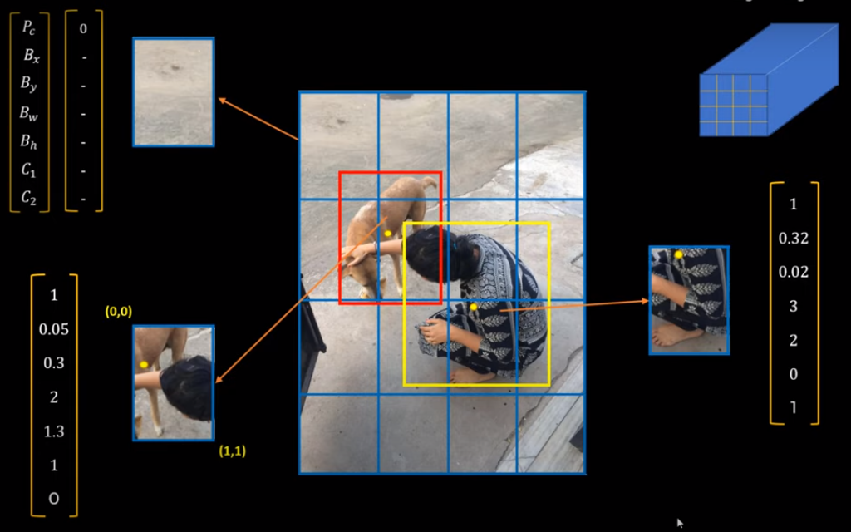
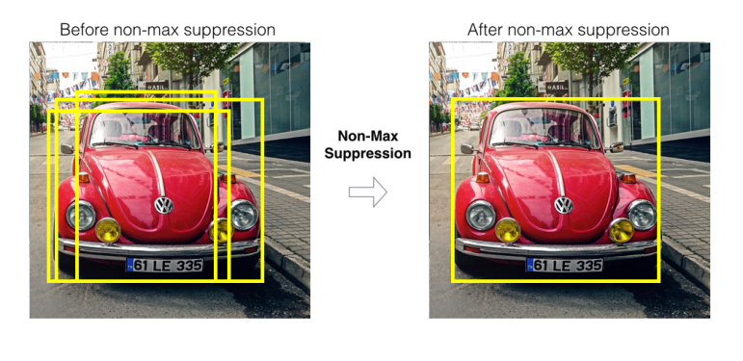
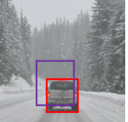
YOLO (you only look once)
Divides image into n x n grid and give vectors of bounding boxes for detected objects.
IOU: intersection over union is a function used to evaluate object detection algorithm.
It computes size of intersection and divide it by the union. More generally, IoU is a measure of the overlap between two bounding boxes
Since yolo detects object multiple times , Non-max Suppression is a way to make sure that YOLO detects the object just once.

Slide 14
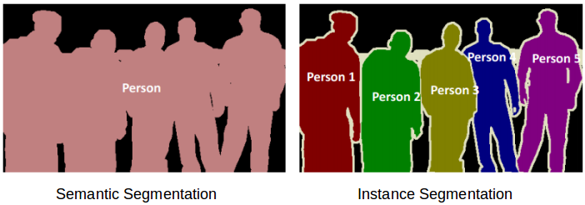
Image Segmentation
It is same as object detection but in addition we get a well defined boundary of objects. In this group together the pixels that have similar attributes.
Types-
Semantic segmentation - All the pixels belonging to a particular class are represented by the same color
Instance Segmentation – In this also a particular class is assigned to each pixel of the image. However, different objects of the same class have different colors.

Slide 15
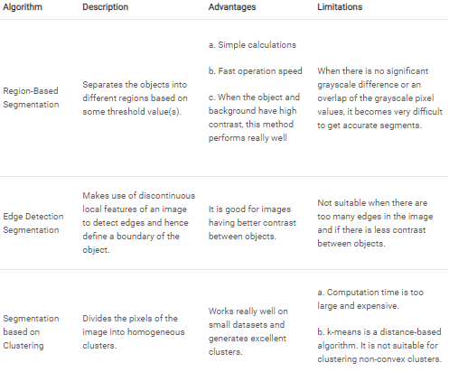

Slide 16
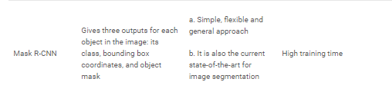
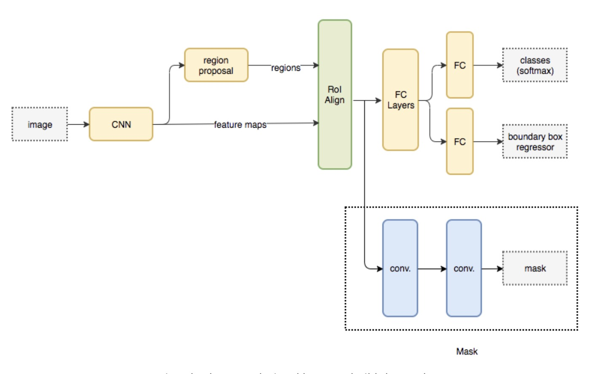

Slide 17
Challenges of data collection and implementation
Image classification | Object Detection | Image Segmentation
Data collection is easy , implementation is also easier if we use pre trained model. If implemented through our own CNN then will take longer to train. | Data collection is a hard task as we have to label objects in each image and generally it is preferred to have 1000 images per class. Once data is collected it is very easy to implement and get output. | Data collection becomes much more challenging than data collection for object collection because now we have to draw boundary around every object
Makesense.ai can be use to lable the images

